Slide 1
Workflow of project
Servlet project

Slide 2
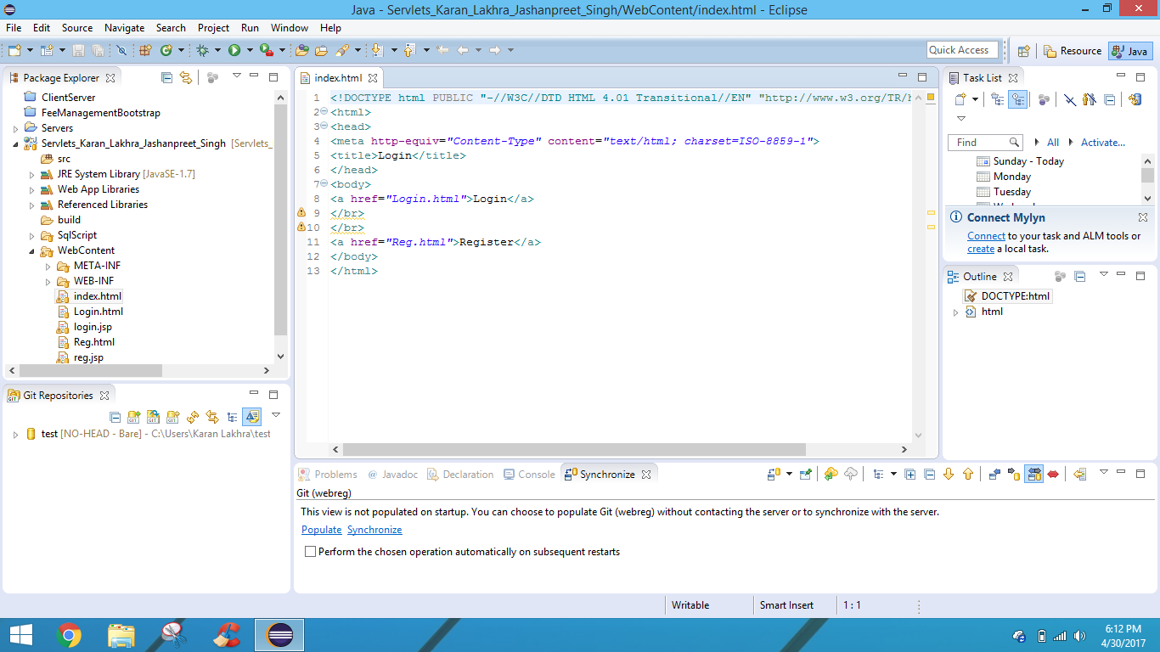
Index page

Slide 3
Index page
In the index page there are two buttons to login and to sign up
If the user is having an account then he has to signed in or if he does not have an account then he has to register first

Slide 4
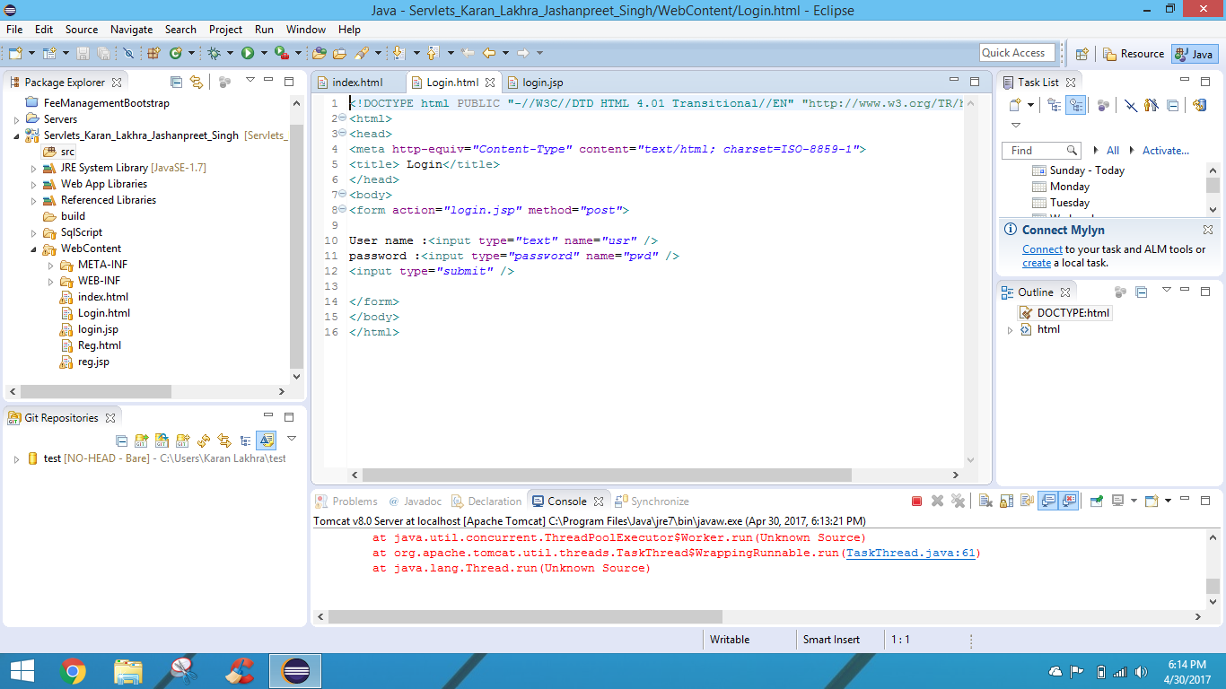
Login page

Slide 5
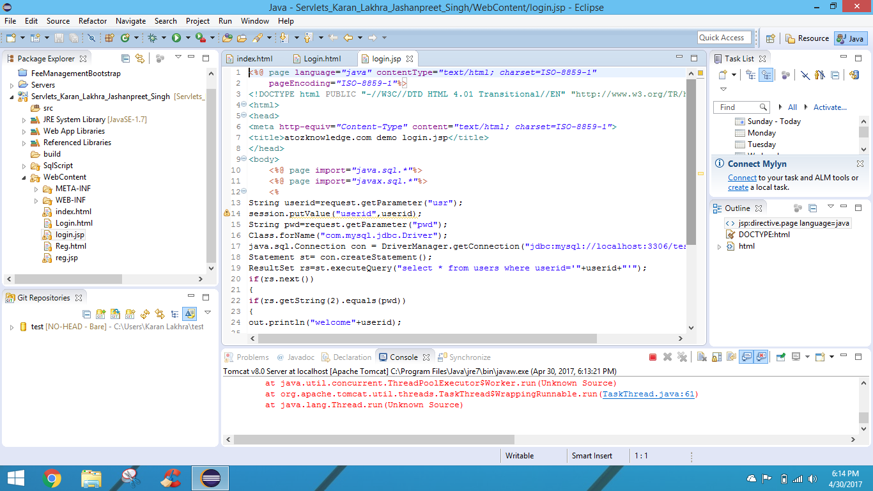
Login.jsp

Slide 6
Login html
From the html page it fetches the data from the jsp page and then the user will able to login and his session will be created until he logged out

Slide 7
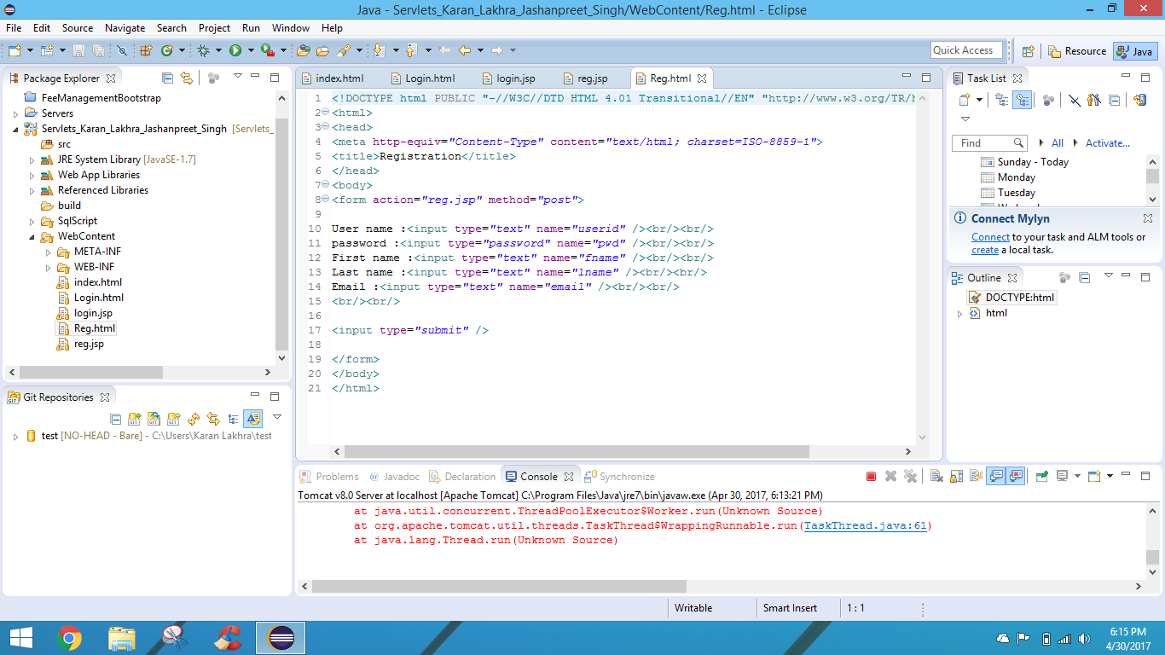
Register.html

Slide 8
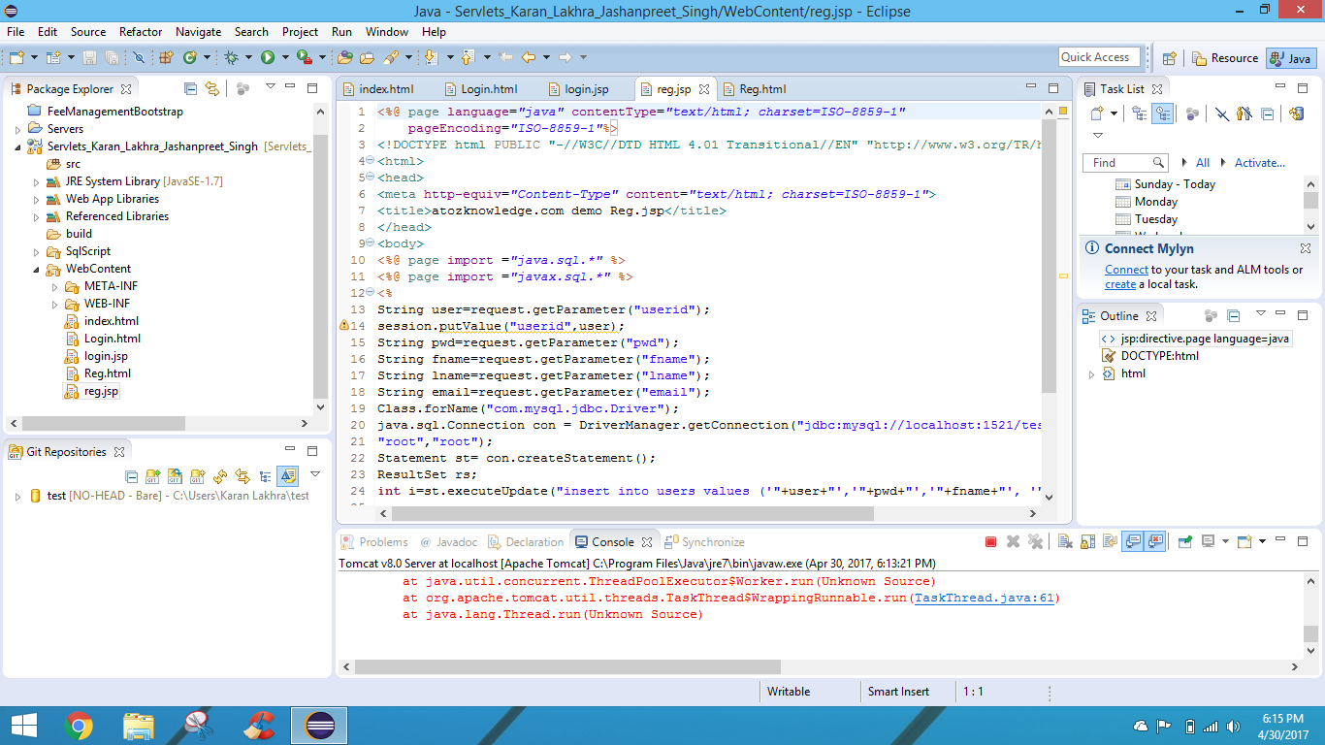
Register.jsp

